Slide 1
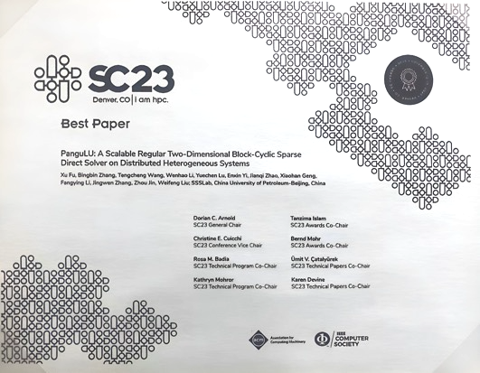

PanguLU: A Scalable
Regular Two-Dimensional Block-Cyclic
Sparse Direct Solver on
Distributed Heterogeneous Systems
Speaker: Weifeng Liu
SC23 paper authors: Xu Fu, Bingbin Zhang, Tengcheng Wang, Wenhao Li, Yuechen Lu, Enxin Yi, Jianqi Zhao, Xiaohan Geng, Fangying Li, Jingwen Zhang, Zhou Jin, Weifeng Liu
New optimization contributors: Yida Li, Yuechen Lu
Super Scientific Software Laboratory, China University of Petroleum-Beijing
Cerfacs, Toulouse, France, 17-18 June 2024
https://github.com/SuperScientificSoftwareLaboratory/PanguLU

Slide 2






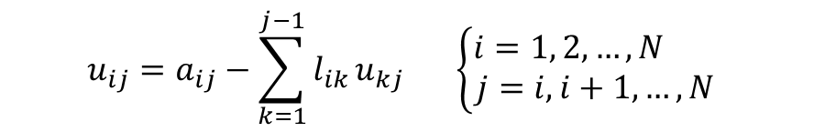



























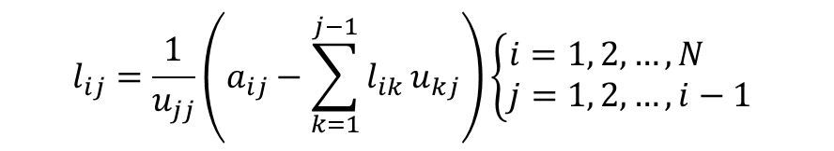















































LU Factorisation
LU factorisation is part of the direct method and is one of the most important tasks in many scientific computing applications. The following figure shows an example of LU factorisation:
$$a$$
$$a$$
$$a$$
$$a$$
$$1$$
$$0$$
$$0$$
$$0$$
$$u$$
$$u$$
$$u$$
$$u$$
$$11$$
$$12$$
$$13$$
$$14$$
$$11$$
$$12$$
$$13$$
$$14$$
$$a$$
$$a$$
$$a$$
$$a$$
$$l$$
$$1$$
$$0$$
$$0$$
$$0$$
$$u$$
$$u$$
$$u$$
$$21$$
$$22$$
$$23$$
$$24$$
$$21$$
$$22$$
$$23$$
$$24$$
$$a$$
$$a$$
$$a$$
$$a$$
=
$$l$$
$$l$$
$$1$$
$$0$$
$$0$$
$$0$$
$$u$$
$$u$$
$$31$$
$$32$$
$$33$$
$$34$$
$$31$$
$$32$$
$$33$$
$$34$$
$$a$$
$$a$$
$$a$$
$$a$$
$$l$$
$$l$$
$$l$$
$$1$$
$$0$$
$$0$$
$$0$$
$$u$$
$$41$$
$$42$$
$$43$$
$$44$$
$$41$$
$$42$$
$$43$$
$$44$$
The elements of L and U are calculated from the following two equations:
$$u_{ij}=a_{ij}−\sum_{k=1}^{j−1}{l_{ik}}u_{kj} \left\{\begin{aligned}i=1, 2,…, N \\ j=i, i+1,…, N\end{aligned}\right.$$
$$l_{ij}=\frac{1}{u_{jj}}\left(a_{ij}−\sum_{k=1}^{j−1}{l_{ik}}u_{kj}\right)\left\{\begin{aligned}i=1, 2,…,N \\ j=1, 2,…,i−1\end{aligned}\right.$$

Slide 3








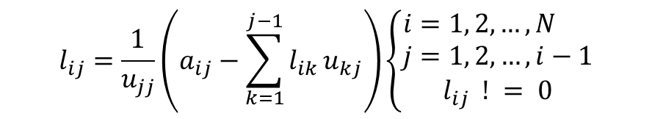





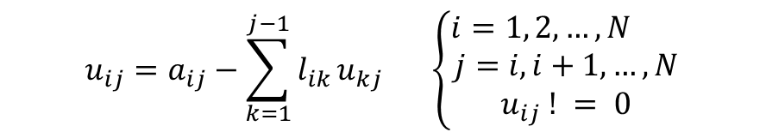




Sparse LU Factorisation
When the input matrix is sparse, the sparse LU factorisation can be used to reduce unnecessary computation and storage, which is called sparse LU factorisation.
For this type of matrix, it is often faster to use sparse LU factorisation.
$$a$$
$$a$$
$$1$$
$$0$$
$$0$$
$$0$$
$$u$$
$$u$$
$$11$$
$$14$$
$$11$$
$$14$$
$$a$$
$$a$$
$$a$$
$$l$$
$$1$$
$$0$$
$$0$$
$$0$$
$$u$$
$$u$$
$$21$$
$$22$$
$$24$$
$$21$$
$$22$$
$$24$$
$$a$$
=
$$1$$
$$0$$
$$0$$
$$0$$
$$u$$
$$33$$
$$33$$
$$a$$
$$a$$
$$a$$
$$l$$
$$l$$
$$1$$
$$0$$
$$0$$
$$0$$
$$u$$
$$41$$
$$42$$
$$44$$
$$41$$
$$42$$
$$44$$
The elements of L and U are calculated from the following two equations:
$$u_{ij}=a_{ij}−\sum_{k=1}^{j−1}{l_{ik}}u_{kj} \left\{\begin{aligned}i=1, 2,…,N \\ j=i,i+1,…,N \\ u_{ij} ! = 0\end{aligned}\right.$$
$$l_{ij}=\frac{1}{u_{jj}}\left(a_{ij}−\sum_{k=1}^{j−1}{l_{ik}}u_{kj}\right)\left\{\begin{aligned}i=1, 2,…,N \\ j=1, 2,…,i−1 \\ l_{ij} ! = 0\end{aligned}\right.$$
Unlike LU factorisation, sparse LU factorisation is divided into the following three phases:
(1) Matrix reordering, (2) symbolic factorisation, and (3) numeric factorisation.

Slide 4
Sparse LU Factorisation
Matrix
reordering
The matrix reordering phase is to reduce fill-in nonzeros and maintain numerical stability.
Symbolic factorisation
The symbolic factorisation phase is to determine the structure of the matrices L and U.
Numeric factorisation
Finally, the numeric factorisation phase is to perform floating-point operations.

Slide 5

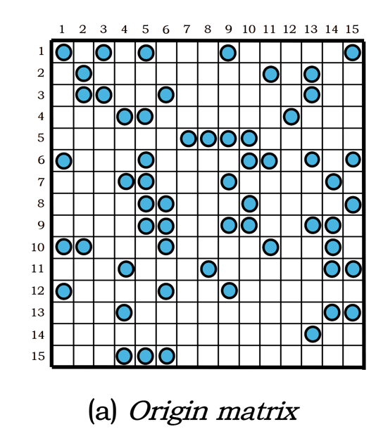
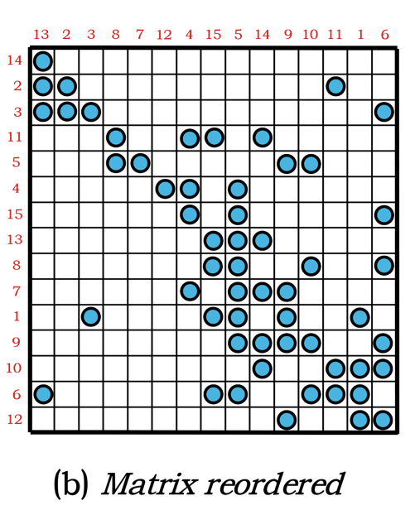
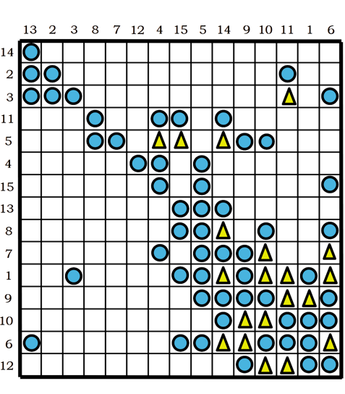
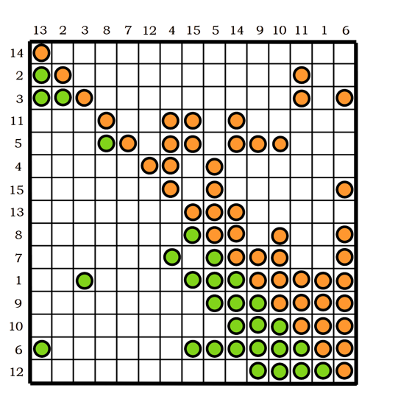


Sparse LU Factorisation
Matrix reordering
Symbolic factorisation
Numeric factorisation
An example of sparse LU factorisation on a 15 x 15 sparse matrix goes through the phases of matrix reordering, symbolic factorisation, and numeric factorisation.

Slide 6

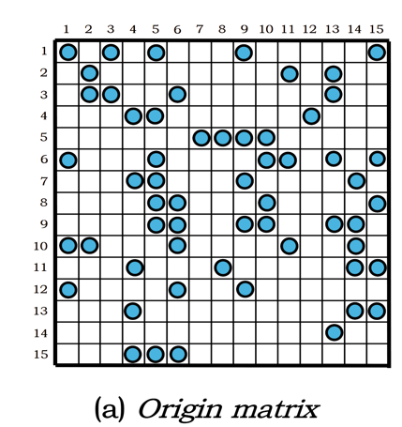
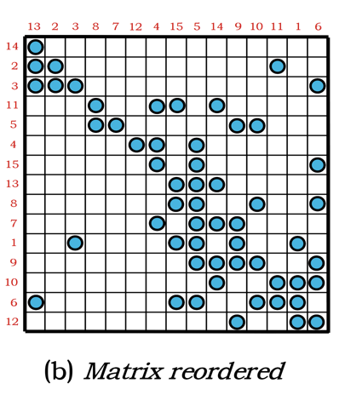
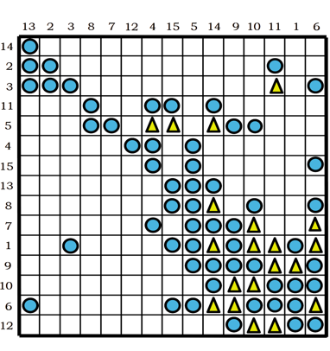
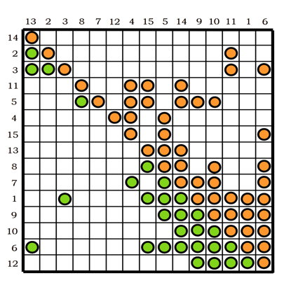
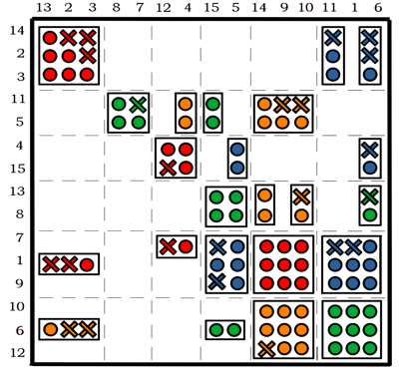


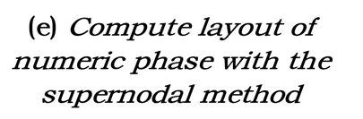
Multifrontal / Supernodal method
Matrix reordering
Symbolic factorisation
Numeric factorisation
Multifrontal/Supernodal
The classic sparse LU factorisation uses multifrontal or supernodal method.
These method aggregates columns with similar structures for using dense BLAS, resulting in good utilisation of modern processors.

Slide 7
Direct Sparse Solver
On Heterogeneous distributed systems
Multifrontal method is proposed by Duff and Reid to improve the efficiency of sparse LU factorisation.(TOMS83)
MUMPS is a distributed direct solver using the multifrontal method. It was developed by Patrick and Duff et al. (PARA00)
SuperLU using supernodal method is developed by Li and Demmel et al. SuperLU_DIST is a distributed version. (TOMS03)
SuperLU_DIST has been continuously updated and added versions for GPU.(JPDC19)
On distributed systems
1983
2001
2003
2004
2010
2015
2019
1990
2000
2010
2020
PARDISO is developed by Schenk et al. It uses a combination of left- and right-looking Level-3 BLAS to exploit parallelism. (FGCS01)
Davis developed UMFPACK which combines pre-ordering and multifrontal method. (TOMS04)
Davis et al also developed KLU, which is a sparse solver for circuit simulation. (TOMS10)
GLU is a sparse direct solver on GPU developed by Tan et al. (D&T20)
Only on share memory CPUs
Only on a single GPU

Slide 8
Outline
Motivation
Uneven Block Sizes
Redundant Zero Fill-ins
High Synchronisation Costs
PanguLU
The Name
Data Layout and Mapping
Sparse Kernels and Algorithm Selection
Synchronisation-Free Scheduling
Experiment
Experimental Setup
Performance Evaluation

Slide 9
Outline
Motivation
Uneven Block Sizes
Redundant Zero Fill-ins
High Synchronisation Costs
PanguLU
The Name
Data Layout and Mapping
Sparse Kernels and Algorithm Selection
Synchronisation-Free Scheduling
Experiment
Experimental Setup
Performance Evaluation

Slide 10
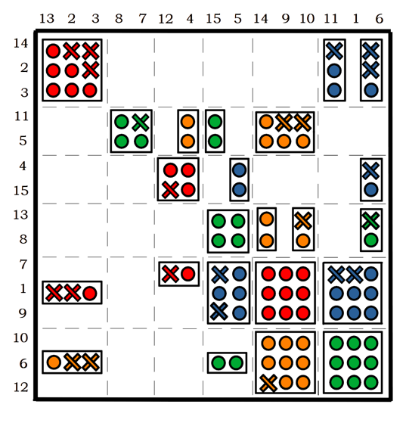
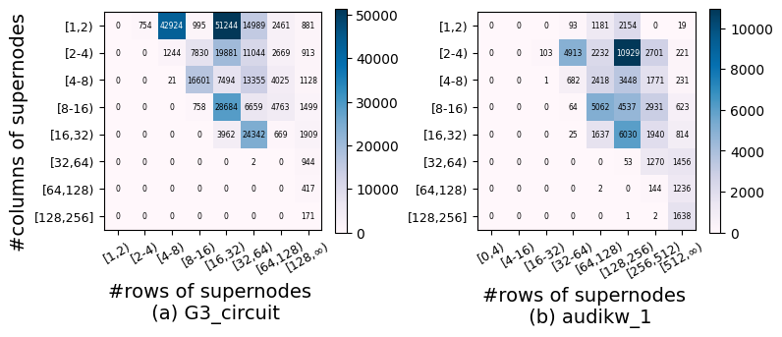
Motivation 1: Uneven Block Sizes
When the supernodal method aggregates columns of the same structure, there are different sizes of supernodes.
In real-world matrices, supernode sizes are quite different.
3
2
2
2
3
3
Multifrontal / Supernodal method
There exist two sizes of supernode
Uneven-size distribution of supernode blocks.
It can be seen that the matrix blocks generated by the supernodes can be very irregular, which often affects the computational efficiency, and their irregular structure makes it difficult to optimise the performance at the kernel level.

Slide 11
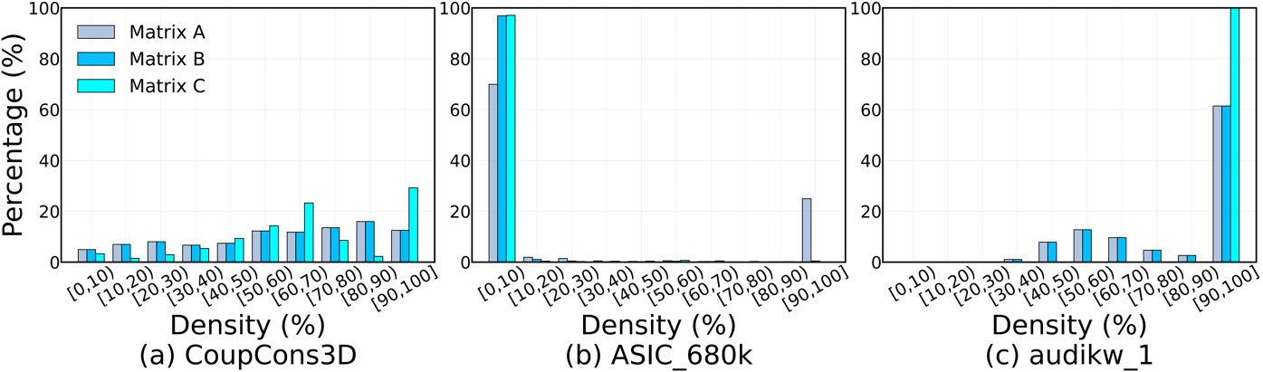
Motivation 2: Redundant Zero Fill-ins
The supernodal method divides the matrix into uneven dense blocks to be computed with dense BLAS, which may cause two questions.
1. Redundant zero fill-ins can occur when forming dense blocks that add extra floating-point operations.
2. The local sparsity of the matrix cannot be exploited during GEMM calculations.
This matrix has an overall even distribution but a significant portion is less than 50%
concentrated at [90,100)%
concentrated at [0,10)%
Multifrontal / Supernodal method
Density distribution of matrices involved in dense BLAS in SuperLU_DIST
As a result, for the two matrices there is a chance that sparse BLAS is faster compared with dense BLAS.

Slide 12
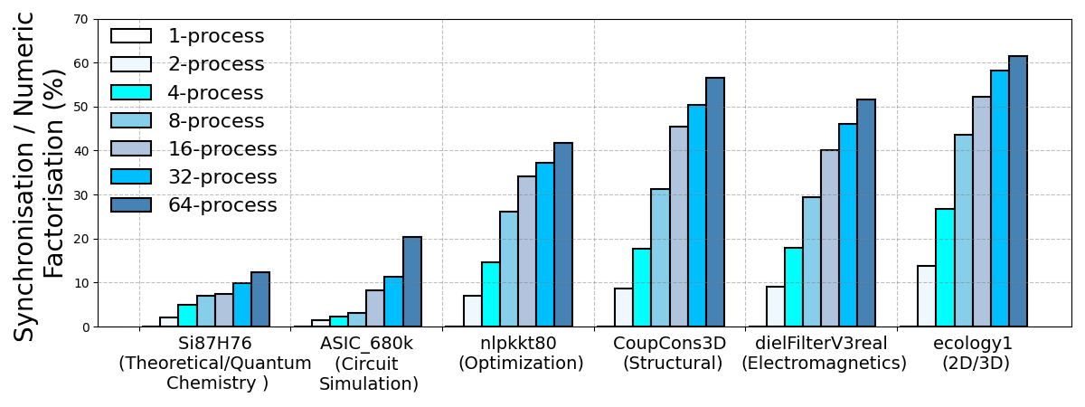
Motivation 3: High Synchronisation Costs
SuperLU_DIST uses the level-set method to generate an elimination tree with tree nodes as the minimum scheduling unit in distributed systems, which can lead to high synchronisation costs.
Tree nodes consist of multiple dense BLAS and there are dependencies between each tree node that need to be synchronised, resulting in additional synchronisation overhead.
6
6
1
5
2
5
3
4
4
4
1
3
5
1
3
6
2
2
SuperLU_DIST on 64 NVIDIA A100 GPUs, from 1 to 64 processes
We test six real-world matrices from SuiteSparse Matrix Collection on 64 NVIDIA A100 GPUs.
The synchronization cost would be more than 50% at 64 processes on irregular matrices.
We need a new method to reduce synchronization costs.

Slide 13
Outline
Motivation
Uneven Block Sizes
Redundant Zero Fill-ins
High Synchronisation Costs
PanguLU
The Name
Data Layout and Mapping
Sparse Kernels and Algorithm Selection
Synchronisation-Free Scheduling
Experiment
Experimental Setup
Performance Evaluation

Slide 14
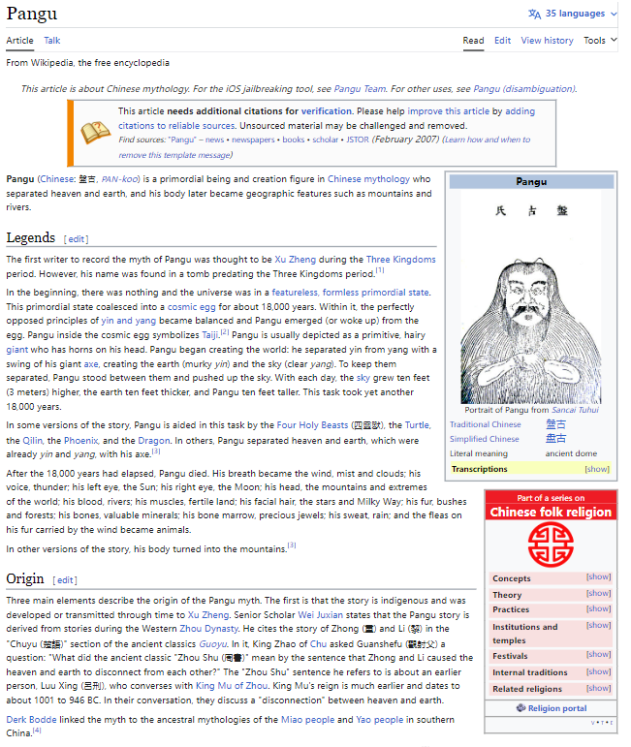




PanguLU: Where is the Name from?
Pangu (Chinese: 盤古, PAN-koo) is a primordial being and creation figure in Chinese mythology who separated heaven and earth, and his body later became geographic features such as mountains and rivers. -- Wikipedia
Wikipedia
Cartoon
Our Logo
https://github.com/SuperScientificSoftwareLaboratory/PanguLU
https://www.ssslab.cn/software.html

Slide 15
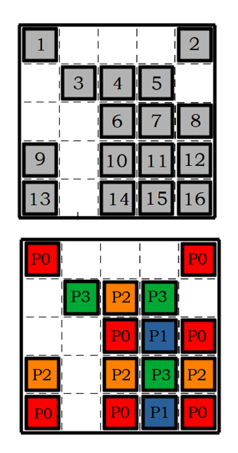
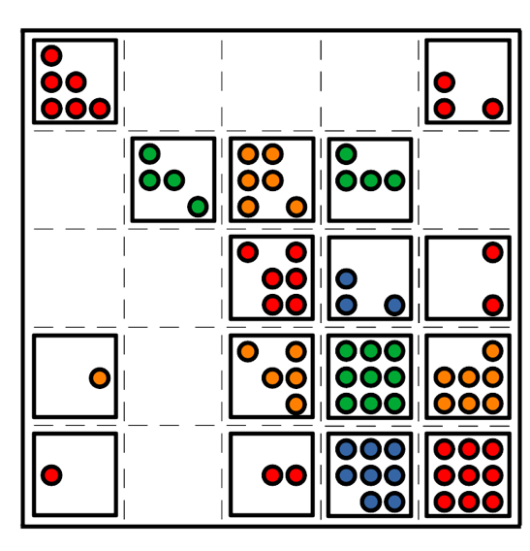
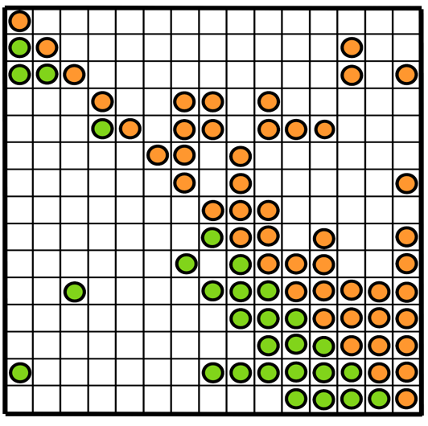
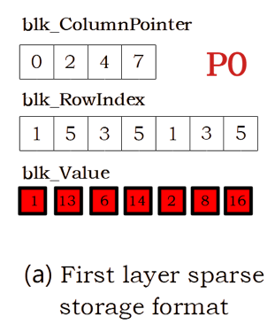
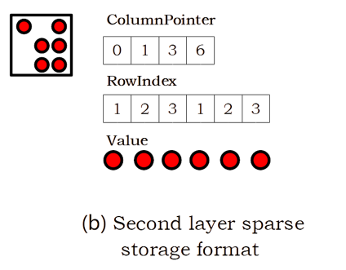
Data Layout of PanguLU
Our approach is completely different from the classic multifrontal and supernodal methods.
PanguLU splits the matrix into multiple blocks of equal size and uses sparse kernel to calculate.
Each process uses a two-layer sparse structure to store the matrix.
First layer sparse structure stores the positional information of sparse matrix blocks. We will get the position of sub-matrix in this layer sparse format.
Second layer sparse structure stores the non-zero elements of sub-matrix block with sparse format. We will get internal information about the block, including rows, non-zeros, and sub-matrix structure.

Slide 16
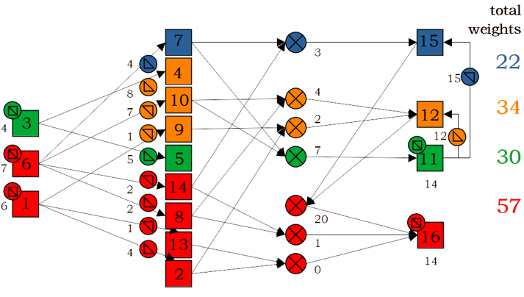
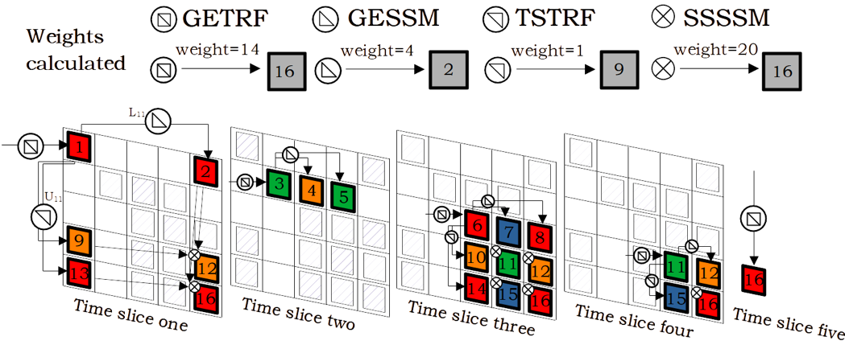
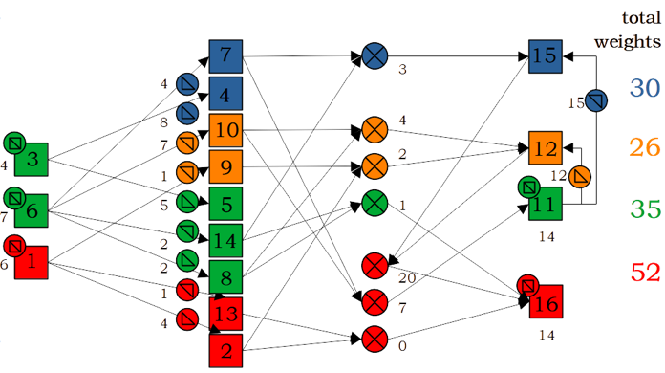
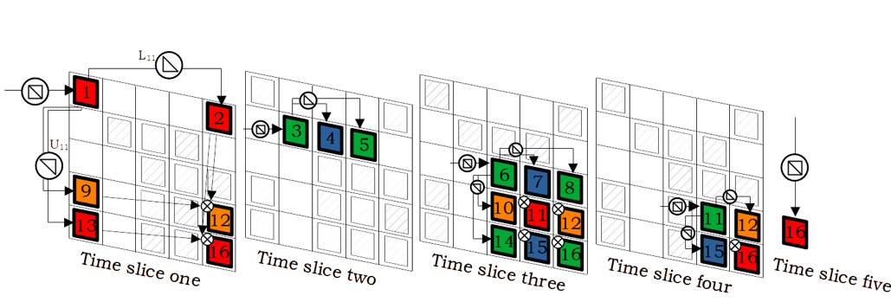
Mapping of PanguLU
PanguLU develops a mapping method and redistributes the computational load between processes. We map sparse block of heavy-load process to less-load process according to kernel types and time slices.
Calculate the total weights of the LU factorisation by preprocessing
Each block presents a sparse kernel
Migrate heavy-load sparse kernels for load-balancing
Exchange load from orange process to blue process
Exchange from red process to green process

Slide 17
Sparse Kernels
In the numeric factorisation of PanguLU, since the matrix blocks are sparse, we develop four dedicated sparse kernels: sparse general triangular factorisation (GETRF), sparse upper triangular solve (TSTRF), sparse lower triangular solve (GESSM), and Schur complement with sparse-sparse matrix multiplication (SSSSM).
A = L * U
X * U = A
L * X = A
- L * U + C = C
All four sparse kernels use sparse sub-matrix blocks as inputs and outputs.

Slide 18
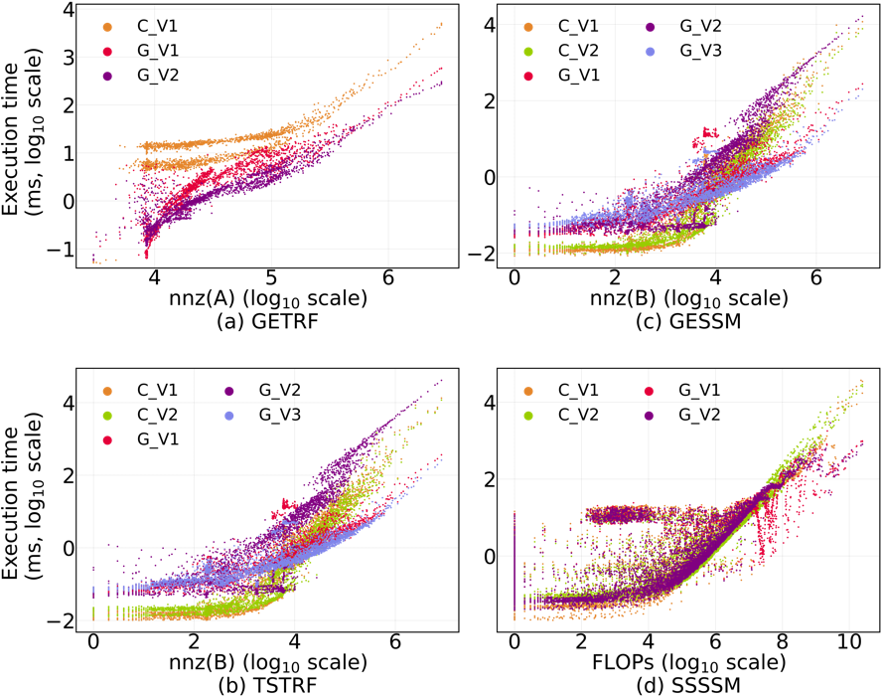
Sparse Kernels
There are several critical factors for the performance of numeric factorsation, such as density, structure and size of the matrix. To exploit the best performance, we implement 17 sparse kernels in PanguLU.
Kernel | Version | Addressing Method | Paralleling Method | Dense Mapping
GETRF | C_V1 | Direct | Row | ✓
 | G_V1 | Bin-search | Un-sync SFLU | -
 | G_V2 | Direct | Un-sync SFLU | ✓
TSTRF/ GESSM | C_V1 | Merge | Column | -
 | C_V2 | Direct | Column | ✓
 | G_V1 | Bin-search | Warp-level column | -
 | G_V2 | Bin-search | Un-sync warp-level row | -
 | G_V3 | Direct | Warp-level column | ✓
SSSSM | C_V1 | Direct | Approximate equal load column block | ✓
 | C_V2 | Bin-search | Adaptive split-bin type | -
 | G_V1 | Bin-search | Adaptive multi-level | -
 | G_V2 | Direct | Warp-level column | ✓
Different sparse kernels have different performance on the structure of different matrices.
The “Addressing Method” indicates how the calculation value is located and updated. In addition, the “Dense Mapping” represents that the sparse structure is mapped to a dense space.
How to select one of these sparse kernels at runtime?

Slide 19
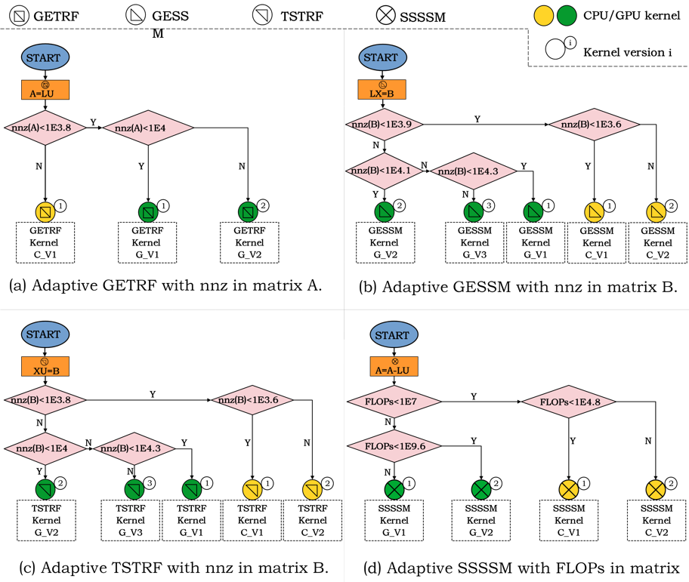
Algorithm Selection
We propose an algorithm selection strategy for constructing sparse kernels based on large amounts of performance data to select better sparse kernels.
We develop four decision trees according to #non-zeros of matrix A/B and the FLOPs involved in the computation from the performance of 17 sparse kernels to guide our algorithm selection.

Slide 20
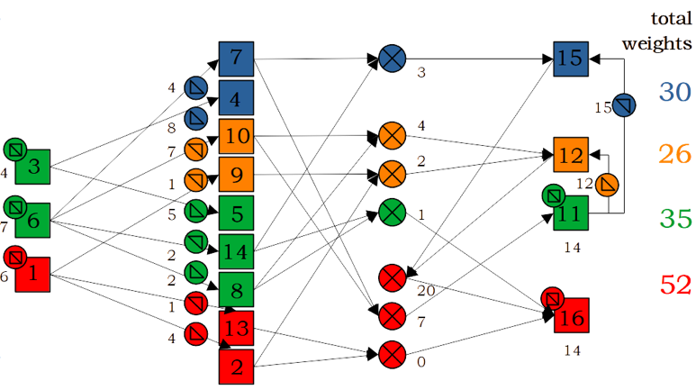
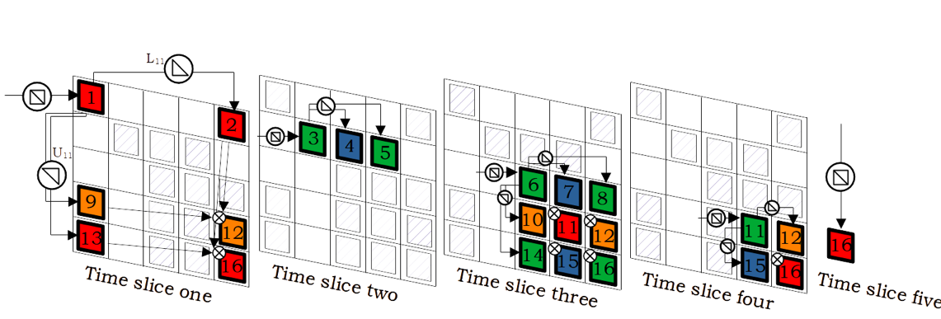
Synchronisation-Free Scheduling
PanguLU are computed sequentially in the order of time slices, to maintain the correctness of the sparse LU factorisation as show in figure.
Executive direction

Slide 21
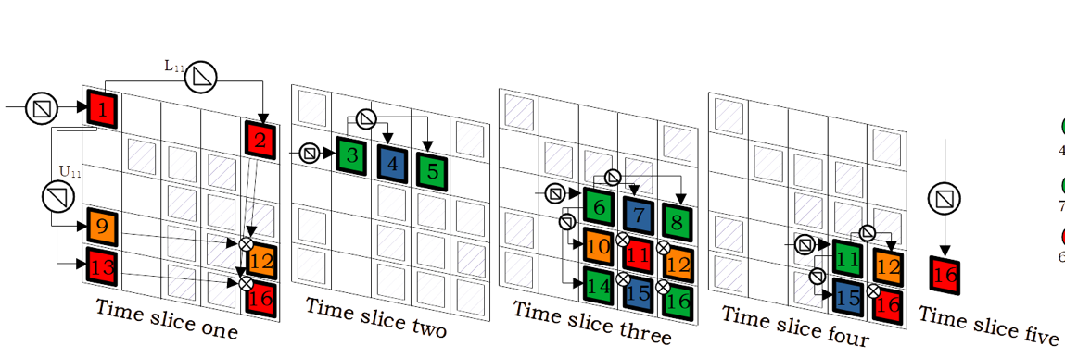
Synchronisation-Free Scheduling
PanguLU are computed sequentially in the order of time slices, to maintain the correctness of the sparse LU factorisation as show in figure.
But obviously these time slices can be computed in parallel on different processes.
Executive direction
Mainly because synchronisation reduces parallelism in distributed systems.
For the blocks 1, 3 and 6, if we do the calculations in time-slice order, these blocks will be executed sequentially.
The synchronisation between each time slice is required to ensure that the correctness of the calculations.
Is there another method of calculation that can guarantee correctness while keeping the processes in a working state as much as possible?

Slide 22
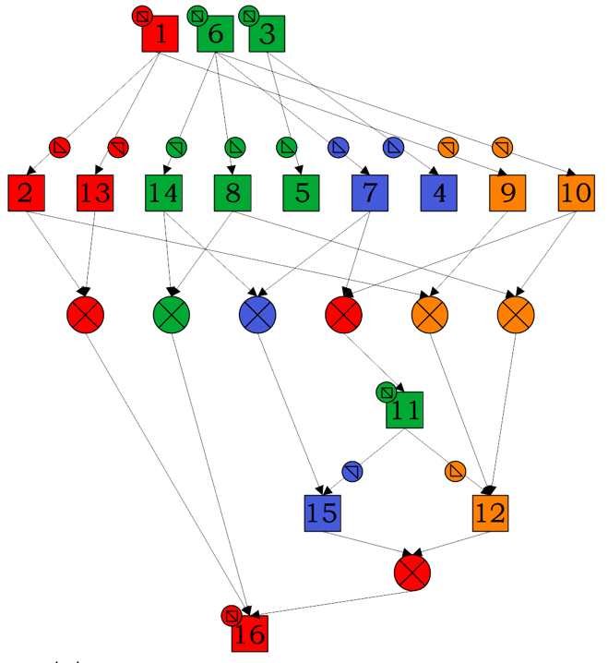
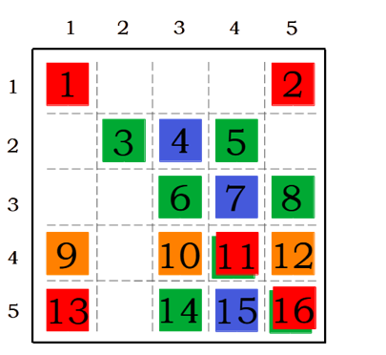
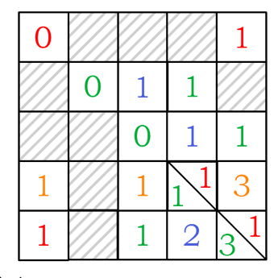
Synchronisation-Free Scheduling
So we researched the order of computation of sparse LU factorisation using sparse kernels.
Therefore, we can use a synchronisation-free array to keep the number of sparse kernels that still need to be calculated for each block to ensure the correctness of the computation.
We find all kernels need to calculate according to the dependencies shown in the figure.
The computation of all sparse kernels (GETRF, TSTRF, GESSM and SSSSM) can only be started after computation of the kernel pointed to by the previous arrow has been completed, which is like the relationship between 0 and non-zero.
For block 1, block 2, and block 6, the synchronisation-free array is 0 because there are no arrows.
For block 12, the synchronisation-free array is 3 because there are three arrows.
In particular, we do not use any synchronisation in here.
Then we need a synchronisation-free scheduling strategy to complete LU factorisation.

Slide 23
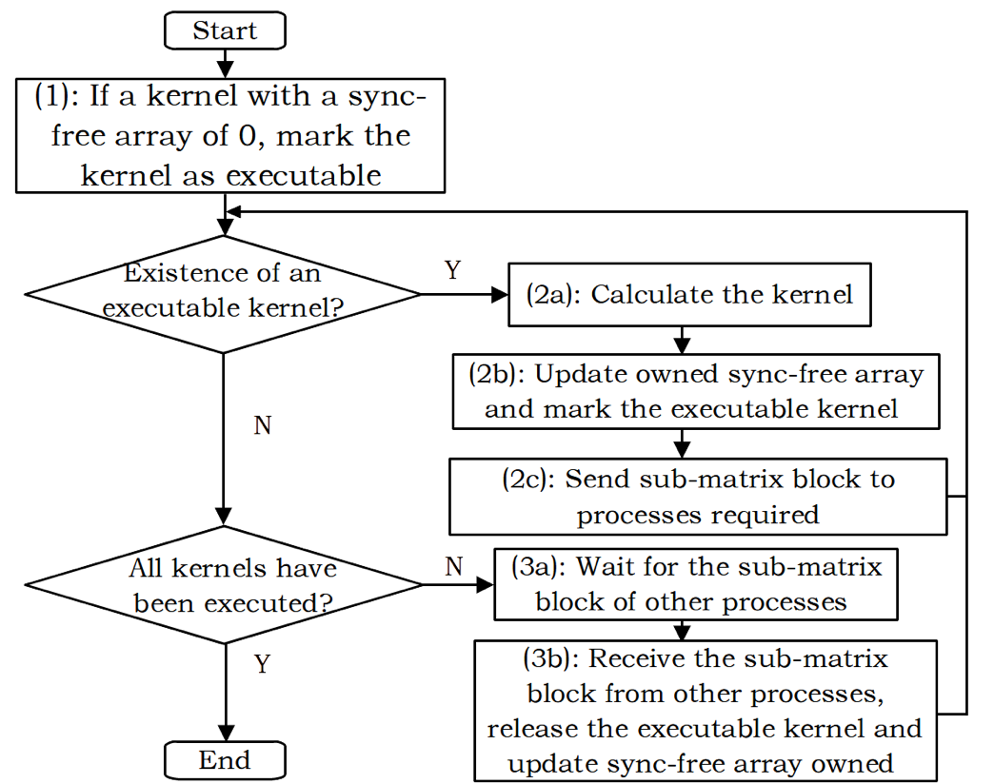
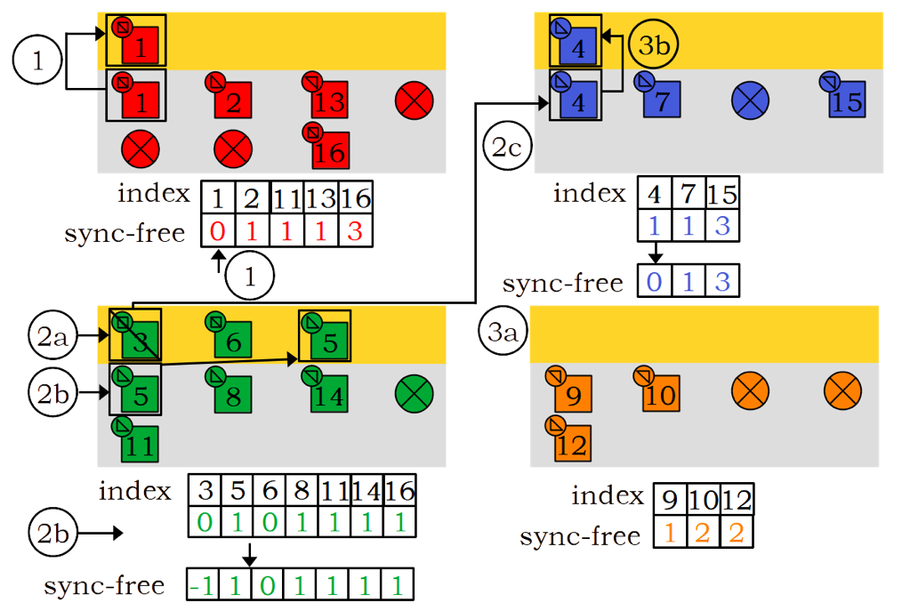
Synchronisation-Free Scheduling
The synchronisation-free scheduling is shown in the left figure, a sample is shown in the right figure.
Each process has a task queue to store executable sparse kernels.
We will use the synchronisation-free scheduling to calculate until the completion of the LU factorisation.

Slide 24
Outline
Motivation
Uneven Block Sizes
Redundant Zero Fill-ins
High Synchronisation Costs
PanguLU
The Name
Data Layout and Mapping
Sparse Kernels and Algorithm Selection
Synchronisation-Free Scheduling
Experiment
Experimental Setup
Performance Evaluation

Slide 25



Experimental Setup
Two experimental platforms | Two heterogeneous distributed Solvers
4 * NVIDIA A100 GPUs (40 GB, B/W 1555GB/s) 2 * Intel Xeon 8180 CPUs @ 2.5 GHz (512GB DDR4) | SuperLU_DIST 8.1.2 PanguLU 3.5
4 * AMD MI50 GPUs (16 GB, B/W 1024GB/s) 1 * AMD Epyc 7601 CPU @ 2.2 GHz (128GB DDR4) | SuperLU_DIST 8.1.2 PanguLU 3.5

Slide 26
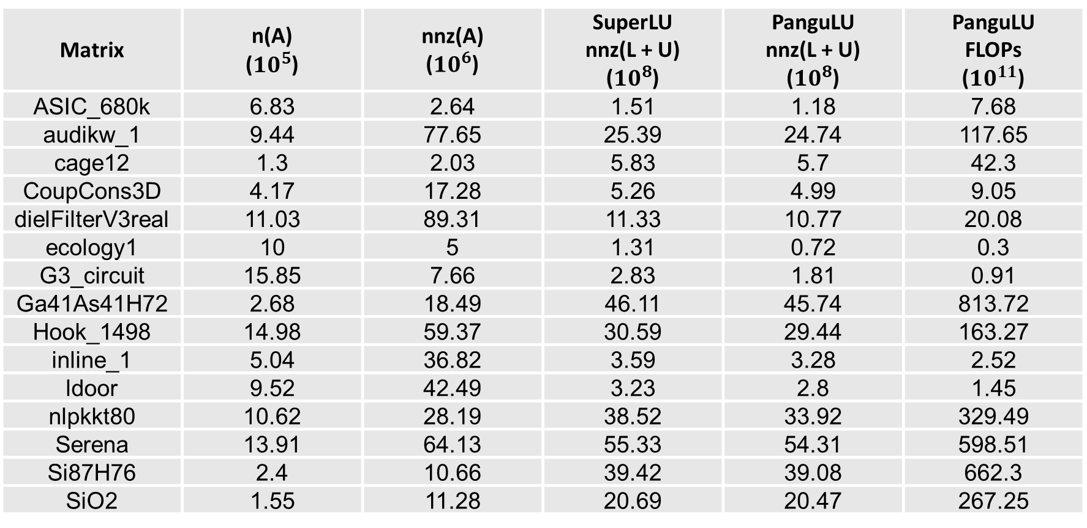
Experimental Setup
16 sparse matrices from the SuiteSparse Matrix Collection.
Matrix | n(A) (${10}^{5}$) | nnz(A) (${10}^{6}$) | SuperLU nnz(L + U) (${10}^{8}$) | PanguLU nnz(L + U) (${10}^{8}$) | PanguLU FLOPs (${10}^{11}$)
ASIC_680k | 6.83 | 2.64 | 1.51 | 1.18 | 7.68
audikw_1 | 9.44 | 77.65 | 25.39 | 24.74 | 117.65
cage12 | 1.3 | 2.03 | 5.83 | 5.7 | 42.3
CoupCons3D | 4.17 | 17.28 | 5.26 | 4.99 | 9.05
dielFilterV3real | 11.03 | 89.31 | 11.33 | 10.77 | 20.08
ecology1 | 10 | 5 | 1.31 | 0.72 | 0.3
G3_circuit | 15.85 | 7.66 | 2.83 | 1.81 | 0.91
Ga41As41H72 | 2.68 | 18.49 | 46.11 | 45.74 | 813.72
Hook_1498 | 14.98 | 59.37 | 30.59 | 29.44 | 163.27
inline_1 | 5.04 | 36.82 | 3.59 | 3.28 | 2.52
ldoor | 9.52 | 42.49 | 3.23 | 2.8 | 1.45
nlpkkt80 | 10.62 | 28.19 | 38.52 | 33.92 | 329.49
Serena | 13.91 | 64.13 | 55.33 | 54.31 | 598.51
Si87H76 | 2.4 | 10.66 | 39.42 | 39.08 | 662.3
SiO2 | 1.55 | 11.28 | 20.69 | 20.47 | 267.25
The number of nonzeros before and after SuperLU_DIST’s symbolic factorisation, the number of nonzeros before and after PanguLU’s symbolic factorisation, as well as the total number of floating-point operations in PanguLU’s numeric factorisation.

Slide 27
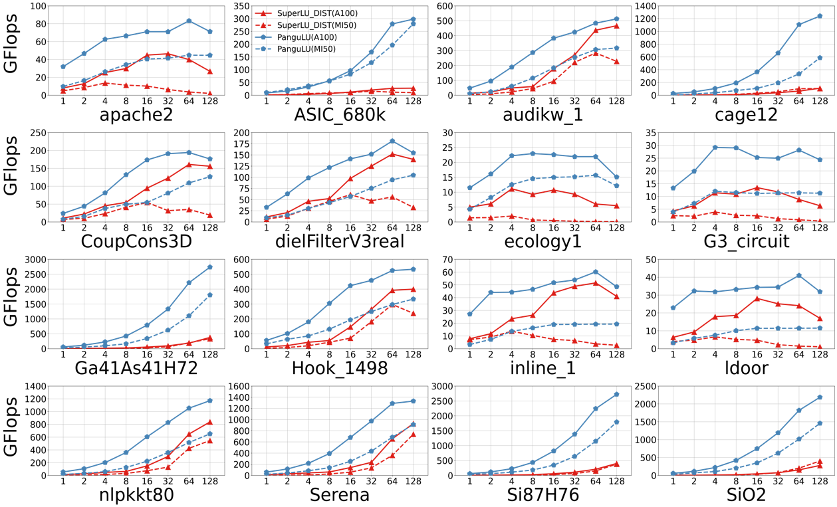
Performance of Numeric Factorisation
Compared with SuperLU_DIST, PanguLU achieves an average speedup of 2.53x and 2.79x on the NVIDIA GPU platform and the AMD GPU platform, with speedups ranging from 1.10x - 11.70x and 1.12x - 17.97x, respectively.
Especially, PanguLU achieves significant performance advantages for irregular matrices such as ASIC_680k with speedups of up to 11.70x and 17.97x on the two GPU platforms, respectively.
PanguLU achieves good scalability on the Ga41As41H72 matrix as the number of GPUs increases. Compared with a single GPU, PanguLU scales to 47.51x and 74.84x on 128 A100 GPUs and 128 MI50 GPUs, respectively.
In this figure, the red lines and blue lines indicate the performance of SuperLU_DIST and PanguLU, respectively, while the solid lines and dotted lines indicate the performance on the A100 GPU and MI50 GPU platforms, respectively.

Slide 28
Kernel Time on a Single GPU
PanguLU achieves better performance by using sparse kernel on a single GPU.
In the 16 matrices, PanguLU has a geometric mean of 6.54x compared with SuperLU.
Matrix | Panel Fact Time (s) |  | Schur Time (s) |  | All Time (s)
 | SuperLU | PanguLU | SuperLU | PanguLU | SuperLU | PanguLU | Speedup
apache2 | 9.4 | 6.32 | 27.36 | 3.86 | 36.76 | 10.18 | 3.61x
ASIC_680k | 3.39 | 3.21 | 982.36 | 17.8 | 985.76 | 21.01 | 46.92x
audikw_1 | 103.44 | 47.94 | 764.83 | 159.35 | 868.27 | 207.29 | 4.19x
cage12 | 15.8 | 13 | 3570.76 | 70.65 | 3586.56 | 83.65 | 42.88x
CoupCons3D | 15.69 | 11.11 | 55.55 | 8.5 | 71.24 | 19.61 | 3.63x
dielFilterV3real | 41.62 | 24.63 | 127.92 | 25.27 | 169.54 | 49.9 | 3.40x
ecology1 | 2.26 | 1.8 | 2.88 | 0.57 | 5.14 | 2.37 | 2.17x
G3_circuit | 5.69 | 4.98 | 14.71 | 1.35 | 20.4 | 6.34 | 3.22x
Ga41As41H72 | 979.85 | 80.91 | 21893.96 | 1275.41 | 22873.81 | 1356.32 | 16.86x
Hook_1498 | 117.77 | 66.3 | 1208.79 | 230.17 | 1326.56 | 296.47 | 4.47x
inline_1 | 10.15 | 6.15 | 19.66 | 2.04 | 29.82 | 8.19 | 3.64x
ldoor | 7.2 | 4.55 | 13.87 | 1.05 | 21.07 | 5.59 | 3.77x
nlpkkt80 | 173.69 | 80.48 | 1816.94 | 537.19 | 1990.63 | 617.68 | 3.22x
Serena | 238.6 | 115.98 | 3551.09 | 899.36 | 3789.69 | 1015.35 | 3.73x
Si87H76 | 152.21 | 74.88 | 17245.73 | 1034.96 | 17397.94 | 1109.84 | 15.68x
SiO2 | 77.78 | 38.57 | 9762.91 | 410.6 | 9840.69 | 449.17 | 21.91x
Geometric Mean | - |  | - |  | - |  | 6.54x
Kernel time comparison of SuperLU_DIST and PanguLU for 16 test matrices on a signle A100 GPU.

Slide 29
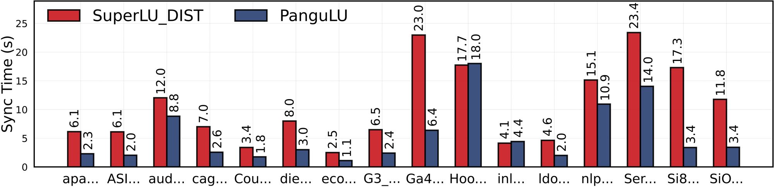
Synchronisation Cost on 128 GPUs
The synchronisation cost of SuperLU_DIST and PanguLU on 128 A100 GPUs
Besides, for structured matrices such as the Hook_1498 and the audikw_1, SuperLU_DIST can more easily form supernodes to make the computation more regular, and the synchronisation overhead is equal to PanguLU.
Result shows the synchronization-free scheduling is effective for most matrices in PanguLU, with an average of 2.20x compared with SuperLU_DIST.

Slide 30
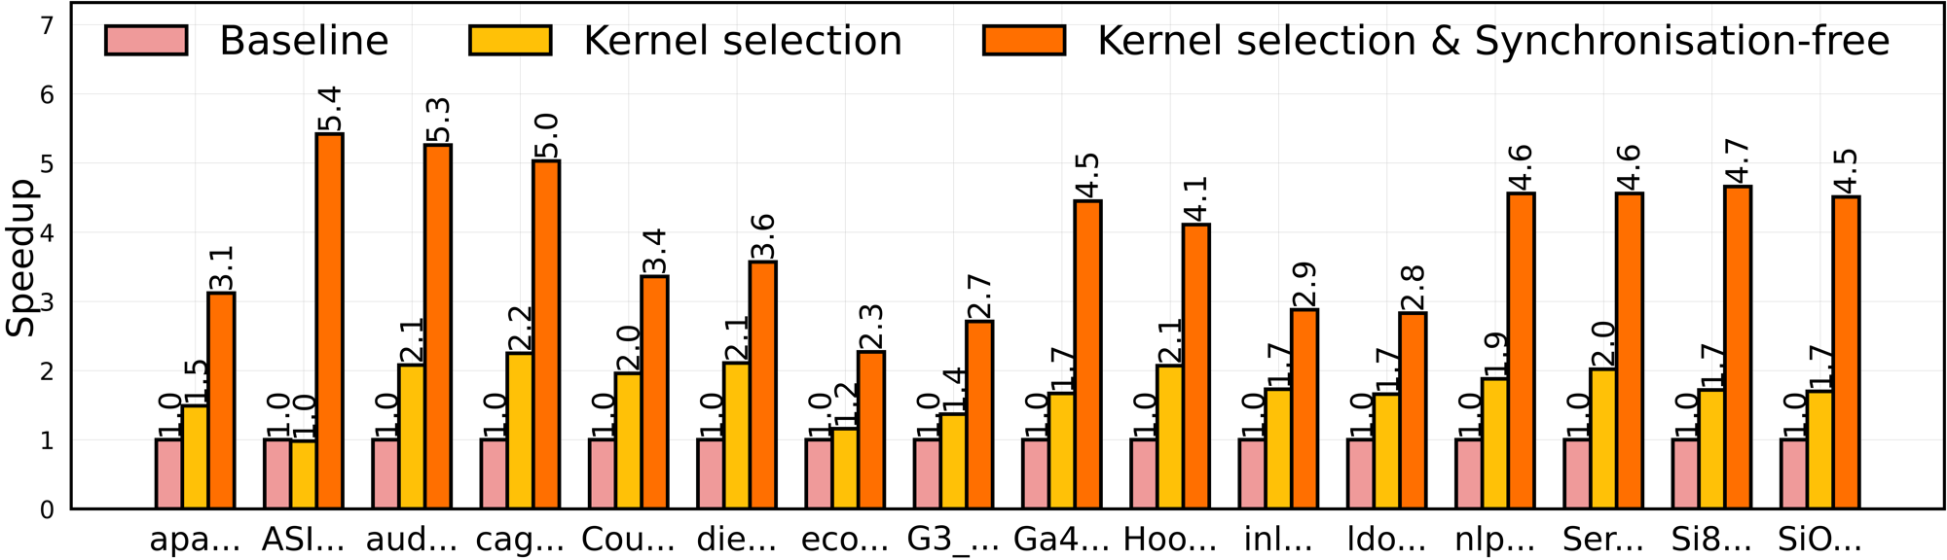
Effects of Different Optimisations
We analyse the effects of the sparse kernel selection and the synchronisation-free scheduling strategy.
For the cage12 and Hook_1498, the sparse kernel selection is very effective and speeds up by a factor of 2.2x and 2.1x, respectively.
Figure shows a performance comparison of the three versions of PanguLU on 128 A100 GPUs.
Compared with the baseline version, selecting faster kernels achieves speedups ranging from 1.0x to 2.2x (1.7x on average).
PanguLU using both the sparse kernel selection and the synchronisation-free scheduling achieves speedups ranging from 2.3x to 5.4x (3.8x on average) over baseline.

Slide 31
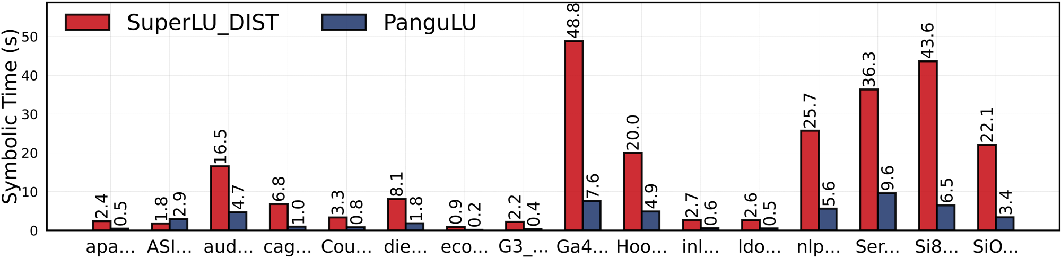
Symbolic Factorisation Time
Then we compare the symbolic factorisation time on SuperLU_DIST and PanguLU. Both solvers use a serial symbolic factorisation algorithm. The difference is that SuperLU_DIST uses pruning and supernodes, whereas PanguLU symmetrises the matrix and uses symmetric pruning.
Compared with SuperLU_DIST, PanguLU is on geometric mean 4.45x faster, with a maximum of 6.80x in the cage12 matrix.
Symbolic factorisation time comparison of SuperLU_DIST and PanguLU.
We also note that symmetric pruning introduces additional fill-ins, especially for highly non symmetric matrices. Although symmetric pruning adds extra non-zeros, PanguLU is able to reduce the fill-ins of non-zeros by 11% compared with the extra non-zeros added by the supernodal method.

Slide 32
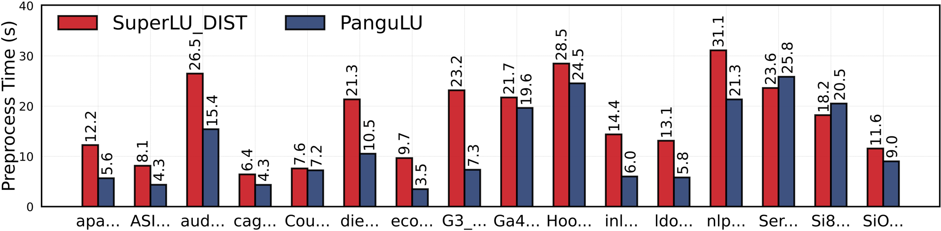
Preprocessing Cost
Finally, to fully demonstrate the overall performance of our work, we also compared the preprocessing time of SuperLU_DIST and PanguLU, and the results are shown in this Figure.
In particular, for sparse matrices such as G3_circuit and inline_1, PanguLU’s preprocessing speed is improved by 3.16x and 2.40x, respectively.
Preprocessing time comparison of SuperLU_DIST and PanguLU on 128 A100 GPUs.
For the Serena and Si87H76 matrices, PanguLU is slightly slower than SuperLU_DIST due to the matrix structure and the higher overhead of converting the 2D block layout, with speedups of 0.91x and 0.89x.
Compared with SuperLU_DIST, PanguLU is on average by a factor of 1.61x faster in the preprocessing phase.

Slide 33
Experimental Setup (recent tests on CPU cores)
An experimental platform | Three distributed solvers
2 * Intel 4th Xeon Max 9462 @ 3.5GHz 64 cores (2 * 32 cores) HBM 128 GB, 2-Level cache mode DDR5 1 TB Memory (64 GB * 16 channels) | MUMPS 5.5.0 SuperLU_DIST 9.0.0 PanguLU 3.5 OpenBLAS 0.3.26 ParMETIS 4.0.3 (64 processes, 1 thread per process)

Slide 34
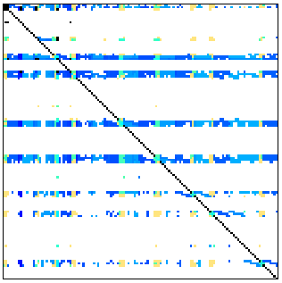
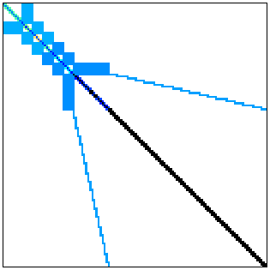
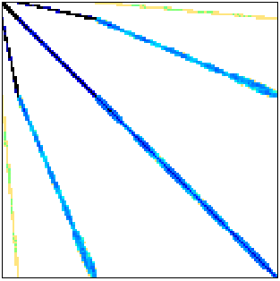
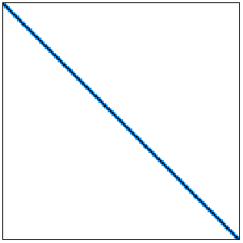
Experimental Results (Circuit and Electromagnetics problems, Time/sec.)
Matrix | Stage | MUMPS | SuperLU DIST | PanguLU
ASIC_680k | symbolic | - | 0.90 | 1.91
 | preproc. | 120.84 | 4.20 | 2.38
 | numeric | 0.40 | 12.26 | 5.55
 | solve | 0.17 | 0.13 | 0.56
 | end to end | 121.40 | 17.79 | 10.4
dielFilterV3real | symbolic | - | 3.96 | 4.87
 | preproc. | 121.78 | 13.00 | 22.21
 | numeric | 14.94 | 4.36 | 15.64
 | solve | 0.18 | 0.11 | 3.18
 | end to end | 136.91 | 21.75 | 45.90
Matrix | Stage | MUMPS | SuperLU DIST | PanguLU
G3_circuit | symbolic | - | 1.26 | 0.80
 | preproc. | 17.89 | 13.11 | 4.38
 | numeric | 2.49 | 2.10 | 9.39
 | solve | 0.20 | 0.11 | 1.31
 | end to end | 20.59 | 16.82 | 15.88
ecology1 | symbolic | - | 0.52 | 0.33
 | preproc. | 10.54 | 6.53 | 2.65
 | numeric | 0.67 | 0.85 | 2.03
 | solve | 0.12 | 0.06 | 0.61
 | end to end | 11.33 | 8.08 | 5.62

Slide 35
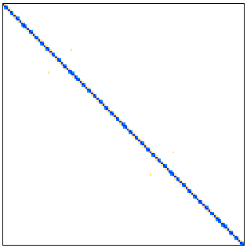



Experimental Results (Structural problems, Time/sec.)
Matrix | Stage | MUMPS | SuperLU DIST | PanguLU
apache2 | symbolic | - | 1.50 | 1.09
 | preproc. | 9.59 | 7.35 | 7.92
 | numeric | 1.98 | 2.21 | 4.92
 | solve | 0.07 | 0.08 | 1.80
 | end to end | 11.65 | 11.31 | 15.75
audikw_1 | symbolic | - | 7.49 | 9.64
 | preproc. | 115.41 | 16.43 | 19.95
 | numeric | 55.85 | 12.25 | 27.54
 | solve | 0.47 | 0.20 | 2.88
 | end to end | 171.74 | 36.66 | 60.03
Matrix | Stage | MUMPS | SuperLU DIST | PanguLU
Hook_1498 | symbolic | - | 9.58 | 11.80
 | preproc. | 91.18 | 17.89 | 39.43
 | numeric | 91.87 | 18.98 | 37.85
 | solve | 0.72 | 0.32 | 4.38
 | end to end | 183.78 | 47.15 | 93.47
inline_1 | symbolic | - | 1.41 | 1.52
 | preproc. | 54.76 | 6.84 | 4.70
 | numeric | 2.45 | 1.44 | 6.01
 | solve | 0.05 | 0.04 | 1.41
 | end to end | 57.26 | 9.83 | 13.65

Slide 36




Experimental Results (Theoretical/Quantum Chemistry/DNA problems, Time/sec.)
Matrix | Stage | MUMPS | SuperLU DIST | PanguLU
Ga41As41H72 | symbolic | - | 26.61 | 17.06
 | preproc. | 26.59 | 12.06 | 10.03
 | numeric | 404.66 | 197.06 | 77.73
 | solve | 2.21 | 1.10 | 1.21
 | end to end | 433.47 | 239.10 | 106.03
Si87H76 | symbolic | - | 22.29 | 14.71
 | preproc. | 17.14 | 9.93 | 8.73
 | numeric | 218.48 | 159.90 | 63.94
 | solve | 1.10 | 0.86 | 1.06
 | end to end | 236.72 | 194.78 | 88.71
Matrix | Stage | MUMPS | SuperLU DIST | PanguLU
SiO2 | symbolic | - | 10.28 | 7.15
 | preproc. | 15.89 | 6.39 | 5.10
 | numeric | 104.26 | 65.95 | 25.23
 | solve | 0.51 | 0.52 | 0.64
 | end to end | 120.66 | 84.64 | 38.13
cage12 | symbolic | - | 3.56 | 2.00
 | preproc. | 5.99 | 2.83 | 1.89
 | numeric | 56.52 | 26.06 | 6.17
 | solve | 0.29 | 0.20 | 0.46
 | end to end | 62.79 | 33.06 | 10.52

Slide 37




Experimental Results (Other problems, Time/sec.)
Matrix | Stage | MUMPS | SuperLU DIST | PanguLU
CoupCons3D | symbolic | - | 1.66 | 2.00
 | preproc. | 58.62 | 3.19 | 3.55
 | numeric | 5.95 | 2.13 | 6.78
 | solve | 0.06 | 0.06 | 1.19
 | end to end | 64.64 | 7.19 | 13.53
ldoor | symbolic | - | 1.39 | 1.38
 | preproc. | 67.64 | 5.08 | 4.51
 | numeric | 1.42 | 1.54 | 10.17
 | solve | 0.04 | 0.06 | 1.58
 | end to end | 69.11 | 8.18 | 17.65
Matrix | Stage | MUMPS | SuperLU DIST | PanguLU
nlpkkt80 | symbolic | - | 13.20 | 14.31
 | preproc. | 43.87 | 23.05 | 28.76
 | numeric | 16.83 | 30.35 | 51.19
 | solve | 0.00 | 0.47 | 3.34
 | end to end | 60.71 | 68.03 | 97.60
Serena | symbolic | - | 15.61 | 20.31
 | preproc. | 92.65 | 19.13 | 41.26
 | numeric | 271.70 | 46.08 | 75.89
 | solve | 1.45 | 0.62 | 4.47
 | end to end | 365.81 | 82.10 | 141.94

Slide 38














Conclusion
PanguLU is a brand new sparse direct solver for large-scale GPU supercomputers.
PanguLU has a novel two-layer sparse structure with blocking and mapping, sparse kernel selection and synchronization-free scheduling strategies are created as well.
PanguLU brings better performance for direct solvers and scales well on heterogeneous distributed systems (now support CUDA, HIP and SYCL).
https://github.com/SuperScientificSoftwareLaboratory/PanguLU
https://www.ssslab.cn/software.html

Slide 39
Many thanks for listening!
Welcome to use our
PanguLU: A Scalable
Regular Two-Dimensional Block-Cyclic
Sparse Direct Solver on
Distributed Heterogeneous Systems
Speaker: Weifeng Liu
SC23 paper authors: Xu Fu, Bingbin Zhang, Tengcheng Wang, Wenhao Li, Yuechen Lu, Enxin Yi, Jianqi Zhao, Xiaohan Geng, Fangying Li, Jingwen Zhang, Zhou Jin, Weifeng Liu
New optimization contributors: Yida Li, Yuechen Lu
Super Scientific Software Laboratory, China University of Petroleum-Beijing
Cerfacs, Toulouse, France, 17-18 June 2024
https://github.com/SuperScientificSoftwareLaboratory/PanguLU

